Slide 1

VIETNAMESE AMERICAN EXPERIENCES
MODEL CURRICULUM 2024
Expressing Culture and Identity through Vietnamese American Music
VAEMC
Vietnamese American Experiences Model Curriculum
Notes:
Area of Study: The Vietnamese Settlement and Community Building
Compelling Question: What is Vietnamese America?
Lesson Question (Supporting Question):
How are evolving Vietnamese American cultures expressed through art, literature, music, and politics?
In what ways did the Vietnamese American community attempt to “preserve” and “evolve” musical styles and forms from pre-1975 Vietnam?
How were competing forms of Vietnamese identity and culture expressed and debated through music in the community?
Lesson Objective: Students will be able to trace a continuity in the history of Vietnamese music before 1975 and how it has evolved in the refugee community through an analysis of different sources. Students will then describe how competing conceptions of Vietnamese identity and culture are negotiated by examining the refugee’s community’s two biggest music entertainment companies.
Lesson Background:
The Vietnamese American refugee music scene, following the events of 1975, initially revolved around preserving the memory of their homeland. In the beginning, few Vietnamese refugees had brought music with them, leading to a community where records and tapes were traded among those who had them. This thirst for connection led to the re-establishment of pre-1975 music houses like Thuy Nga Productions and Asia Entertainment, which started a division called "Paris By Night" in France and the "ASIA Show" in Orange County. Both entertainment shows aimed to cater to the diasporic Vietnamese community's longing for leisure and nostalgia. The prevailing sentiment of nostalgia meant that much of the music produced in this diaspora focused on ballads and songs that were popular before 1975, reflecting themes of lost homeland, patriotism, and the refugee experience. Over time and generations, the nostalgic musical style of the Vietnamese refugee community had evolved in line with the vogue of American pop music, entering new forms such as disco, new wave, rap, R&B, and other genres.
"Paris By Night" (PBN) and Asia Entertainment (ASIA) still remain the most prominent features of the Vietnamese refugee first generation. Both showcase Vietnamese diasporic culture, but with contrasting visions. PBN, produced by Thuy Nga Productions, emphasizes a cosmopolitan and modern Vietnamese identity, intertwining it with the "American dream" and high-end Hollywood aesthetics, avoiding overt political messages and focusing on upward mobility and modern sensibilities. On the other hand, ASIA roots its content in pre-war and war-era South Vietnamese culture, encapsulating the sentiments and experiences of Vietnamese American refugees. With an explicit anti-communist stance, ASIA emphasizes cultural preservation and champions a more traditional and exilic Vietnamese identity, as both styles clash among the Vietnamese, American, and Vietnamese American communities over how to both "preserve" and "evolve" Vietnamese culture and identity in their new homes abroad.

Slide 2
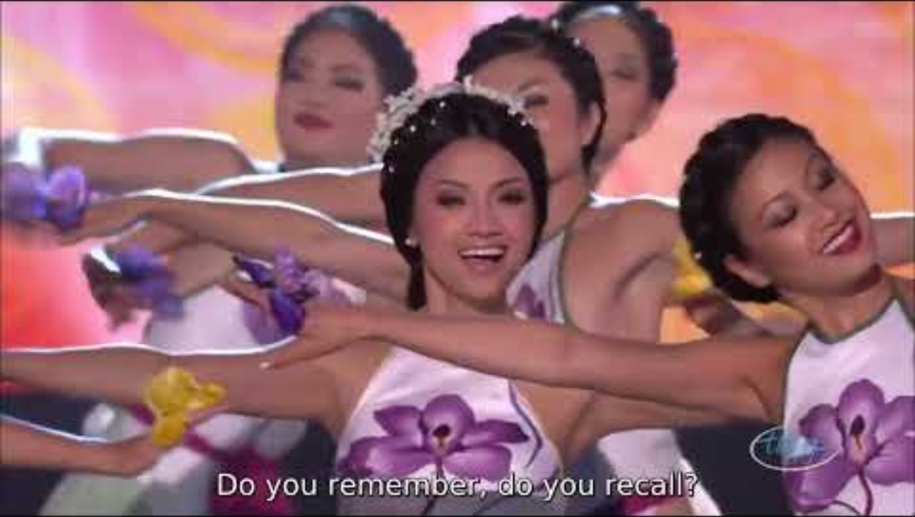
Tung Bay and Cò Lả by Paris by Night
Write down as many adjectives as possible that describe Vietnamese American music based on this video.
Notes:
Cultural Energizer and Lesson Introduction: Show “Tung Bay and Cò Lả by Paris by Night” music video (10 min)
The video can be found in the link here: (subtitles) https://www.youtube.com/watch?v=_OSqOhweCx0
https://www.youtube.com/watch?v=LzsfHIEWG-o (no subtitles)
The lyrics can be found in the handouts section (see: “Flying in the Air and the Wandering Stork (Medley) Lyrics”)
During the video, the teacher will have students get out a piece of paper and write down as many adjectives as possible that they would use to describe Vietnamese American music based on this video
Responses should touch upon the two sections of the video: modern, cosmopolitan, poppy, sexy vs. traditional, alluring, beautiful, and dignified
After the video is done playing, the teacher will give students 1-2 minutes to talk with a partner on what they wrote and how they would describe Vietnamese American music.
The class will come together and share their answers
Discussion questions:
Does this music video feel Vietnamese? Does it feel American? Both?
How would you describe the two different sections of the video?
How do you feel Vietnamese American music has evolved and become unique? How do you think it changed since 1975 when the first Vietnamese refugees came to the U.S.?

Slide 3
Overview of Vietnamese Music
  How did the Vietnamese refugee community inherit and evolve music in South Vietnam before 1975 into its own musical culture?
  How did the themes and styles of music by Vietnamese Americans evolve in the second generation? Did they retain any aspects of their parents’ generation?
Notes:
Shared Learning: History of Vietnamese Refugee Music (15–25 min)
The teacher will pass out, or have students access on devices: three articles, “A Brief History of Paris by Night, the Anchor of Vietnamese Culture Abroad”, “This is the Music of Vietnamese Refugees,” and Source 1: “History of Vietnamese Refugee Music”
The articles can be found here:
“A Brief History of Paris by Night, the Anchor of Vietnamese Culture Abroad”: https://saigoneer.com/saigon-music-art/25830-a-brief-history-of-paris-by-night,-the-anchor-of-vietnamese-culture-abroad
“This is the Music of Vietnamese Refugees”: https://dvan.org/2022/10/music-vietnamese-refugees/
Source 1: “History of Vietnamese Refugee Music”: found in the handout
“Source Sheet: Vietnamese American Music”
The teacher will have students get into 6 groups and read their assigned reading together (2 groups per reading)
The teacher will share a link to a Google Slides presentation (or equivalent) with the class with six questions for each group to discuss:
1. Overview of Vietnamese Music
How did the Vietnamese refugee community inherit and evolve music in South Vietnam before 1975 into its own musical culture?
How did the themes and styles of music by Vietnamese Americans evolve in the second generation? Did they retain any aspects of their parents’ generation?
2. Saigoneer
How did "Paris by Night" serve as a cultural touchstone for the Vietnamese diaspora, capturing the essence of nostalgia, hope, and loss, and how did its evolution reflect the changing sentiments and needs of the displaced Vietnamese community over the years?
Describe the journey challenges did Tô Văn Lai face in both establishing and maintaining "Paris by Night" as an emblematic hallmark of Vietnamese culture abroad?
3. History of Vietnamese Refugee Music
How has Vietnamese music served as a bridge connecting Vietnamese refugees and immigrants to their homeland and memories, and how has this connection influenced the evolution of Vietnamese American music?

Slide 4
Saigoneer
  How did "Paris by Night" serve as a cultural touchstone for the Vietnamese diaspora, capturing the essence of nostalgia, hope, and loss, and how did its evolution reflect the changing sentiments and needs of the displaced Vietnamese community over the years?
  Describe the journey challenges did Tô Văn Lai face in both establishing and maintaining "Paris by Night" as an emblematic hallmark of Vietnamese culture abroad?

Slide 5
History of Vietnamese Refugee Music
  How has Vietnamese music served as a bridge connecting Vietnamese refugees and immigrants to their homeland and memories, and how has this connection influenced the evolution of Vietnamese American music?
  In what ways have political, cultural, and commercial pressures shaped Vietnamese American musical themes, particularly in terms of nostalgia and innovation?

Slide 6
Beginning Stages of Vietnamese Refugee Music
Thúy Nga Productions (Paris by Night) and Asia Entertainment
  Anh Bằng (founder of Asia): soldier, playright, band member of group Lê Minh Bằng in South Vietnam. Fled in 1975 and founded Dạ Lan Entertainment in Westminster, CA, 1981.
  Tô Văn Lai (founder of Thúy Nga): teacher and music producer of Thúy Nga productions that existed in South Vietnam previously fled in 1976 to France, unsuccessfully tried to rebuild Thúy Nga in France and decided to move to Southern CA in 1983 after meeting Anh Bằng and seeing the large Vietnamese American community.
Notes:
The teacher will go over a brief history of how the two music entertainment companies, Asia Entertainment and Thúy Nga Entertainment, became the new most recognizable companies that showcased the best of Vietnamese American popular culture and music.

Slide 7
Paris by Night vs. Asia Entertainment
  What does a Vietnamese refugee identity mean after 1975? This was the overarching question for every artist instilled in a culture that emphasized culture as an agent of Vietnamese modernity and civilization.
    Paris by Night/Asia Entertainment: This ideal Vietnamese image is reflected on a stage that “grapple[s] with immigration, alienation, and displacement in a manner reflecting a newly forged bourgeois identity” (Lieu 2007, 206).
    Flashy, cosmopolitan, modern, glamourous, transnational, transcends politics, evolving culture. Vietnamese refugee identity as a proud inheritor of the “golden age” culture of South Vietnam and situating it within modern, American pop culture
    Anti-communism as modus operandi, uniquely pre-1975 Vietnamese, politics premised on refugee identity, maintaining culture
Notes:
The teacher will have students share what they wrote in their graphic organizers.
The teacher will also show students the main differences in style in the chart on the slide and compare it to student responses.
Go to discussion questions on the next slide.

Slide 8
Discussion Questions
  What are the two conceptions of Vietnamese identity that are presented by the two companies?
  What do you think these two styles say about the way the refugee community attempts to grapple with the need to both preserve and evolve Vietnamese culture and identity abroad?
  How do both companies contribute to the building of a unique Vietnamese refugee identity abroad? How does this factor in as the refugee community is cognizant that both styles of music are restricted or banned in Vietnam from 1975 to the 1990s?
  What is the importance of these companies besides entertainment for the refugee community? How do you think the refugee community sees the growth of Vietnamese culture and music abroad?
Notes:
4. Possible answer for #4: Since Vietnamese culture has “died” and been restricted in VN, those abroad have a duty to ensure that Vietnamese culture continues to evolve into “modernity” while also preserving its best elements before 1975.

Slide 9

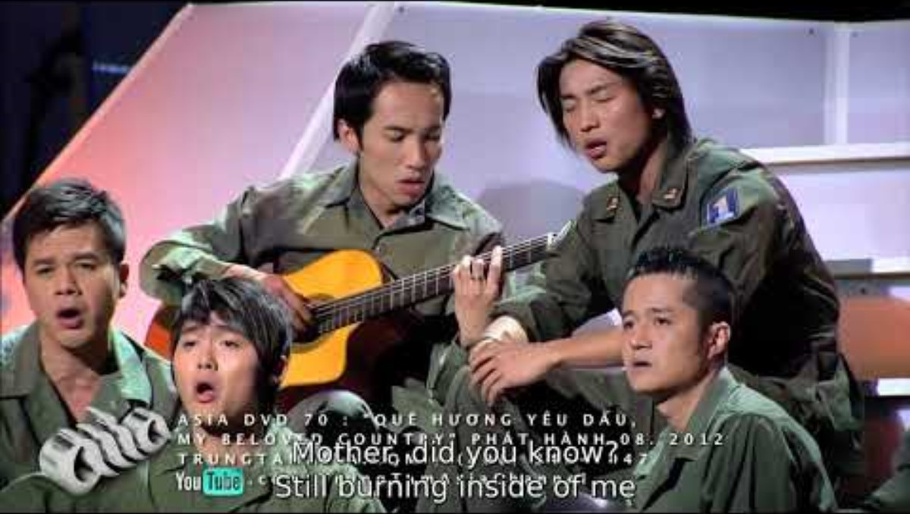
Paris by Night vs. Asia Entertainment
Notes:
Community Collaboration (10 minutes)
The teacher will play both videos:
ASIA: “Remembering Mother” (Nhớ Mẹ): https://www.youtube.com/watch?v=YZ9Cmyyhf_I (subtitles) https://www.youtube.com/watch?v=j5QI4H5rHbo (no subtitles)
Paris by Night: “What's the Point of Love?” (Yêu Làm Chi): https://www.youtube.com/watch?v=8PNt8GKQFSo (subtitles) https://www.youtube.com/watch?v=4xNrS9l3qGU (no subtitles)
During the video, the teacher will ask students to append to their graphic organizer with observations on imagery, sound, tone, mood, lyrics, and meaningful quotes.

Slide 10
Community Collaboration
  Which song/company do you think represents Vietnamese culture better? Why or why not?
  Which song/company style fits your taste better? Why or why not?
  In 2023, which style do you think has been more successful? In the U.S.? In Vietnam? In the Vietnamese refugee community? Why or why not?
Notes:
The teacher will do a final activity in which pairs are instructed to stand up as a team. The teacher will ask a number of questions for students and pairs will move and explain to another pair that has a differing view why they agree or disagree. (10 minutes)
Each question round should be around 1-2 minutes
Questions:
Which song/company do you think represents Vietnamese culture better? Why or why not?
Which song/company style fits your taste better? Why or why not?
In 2023, which style do you think has been more successful? In the U.S.? In Vietnam? In the Vietnamese refugee community? Why or why not?
Reflection Closure (10 min)
After the questions, the class will come back together for a final discussion/reflection
Student pairs will share their thoughts on 1 of the 3 lesson questions.
Extension reflection: Discussion question by teacher: Thinking about your answers, what do you think the future of Vietnamese American music will look like? Will it be more like Paris by Night or like ASIA? Is this future a good or bad thing for the refugee community and why?

Slide 11
Reflection
Thinking about your answers, what do you think the future of Vietnamese American music will look like?
Will it be more like Paris by Night or like ASIA?
Is this future a good or bad thing for the refugee community and why?
Notes:
Reflection Closure (10 min)
After the questions, the class will come back together for a final discussion/reflection
Student pairs will share their thoughts on 1 of the 3 lesson questions.
Extension reflection: Discussion question by teacher: Thinking about your answers, what do you think the future of Vietnamese American music will look like? Will it be more like Paris by Night or like ASIA? Is this future a good or bad thing for the refugee community and why?

