Slide 1

HMONG HISTORY AND CULTURAL STUDIES MODEL CURRICULUM 2024
Cov Hmoob thiab Kob Tsov Rog Qab Rooj hauv Tebchaws Nplog
HHCSMC
Hmong History & Cultural Studies
Model Curriculum
Notes:
Area of Study: Hmong Histories
Compelling Question: How does displacement and war shape Hmong histories and migration?
Lesson Questions (Supporting Questions):
Why did the U.S. recruit the Hmong people to fight in the Secret War in Laos?
What role did the Cold War play in creating Hmong refugees?
How did the Hmong people get involved in the Secret War?
What was the U.S.’s motivation for orchestrating a secret proxy war in Laos?
What happens when a war is hidden from the public?
What economic, political, and social outcomes were accomplished from the war in Laos?
What are the factors that shaped Hmong history during the pre-Cold War era, the Secret War, and post 1975?
Lesson Objective: After students learn about what the Cold War is and how it was carried out in Southeast Asia through the Vietnam War, students will analyze the Secret War that took place in Laos, the role that Hmong played, and the impact it had on Hmong people.
Background information (for the teacher):
The Secret War in Laos is not often taught in U.S. History, but needs to be recognized. It is connected to the Cold War through the Vietnam War, and it was conducted and led through the U.S. Central Intelligence Agency (CIA). Although the U.S. did not send ground troops, the U.S. was intricately involved by providing funding, military weapons, and uniforms to those willing to fight the communists. Among those willing to fight the communists were the Hmong. The CIA operative Bill Lair contacted Vang Pao, a Hmong general and worked out an agreement whereby Vang Pao would recruit Hmong soldiers, and the CIA would provide the uniforms, weapons, and training. Over 30,000 Hmong soldiers were recruited–some as young as 11-years-old. They rescued downed American pilots, protected their territory and fought the communists. Some were trained to fly planes to run bombing missions to bomb out the Ho Chi Minh Trail.

Slide 2
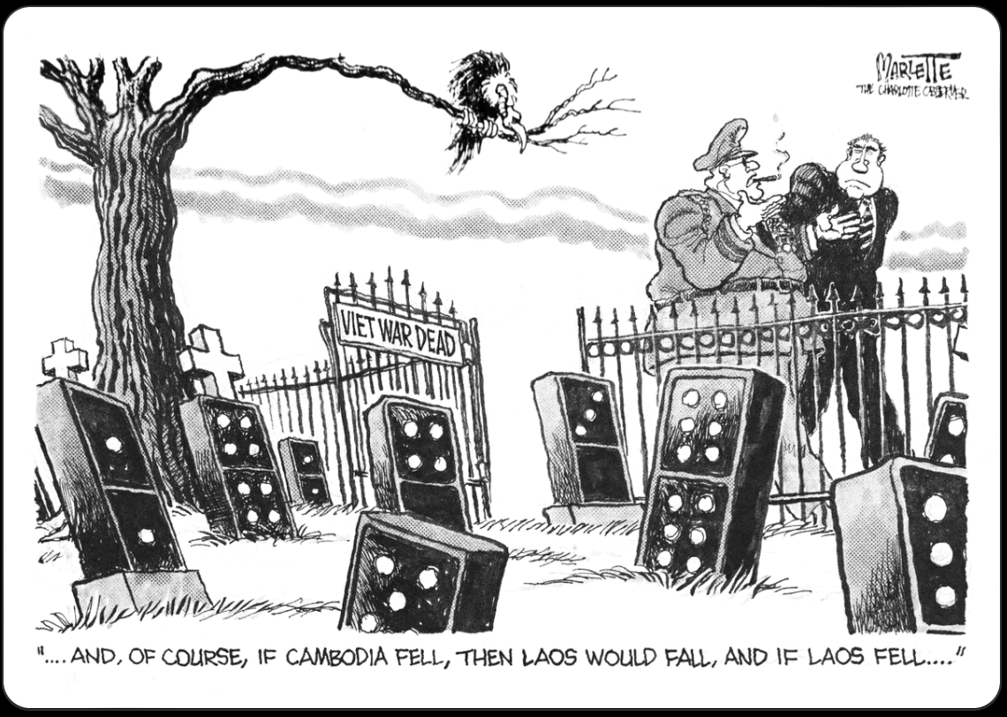
Let’s Examine and Connect
Saib daim duab nom tswv tas lauv no.
Koj pom dab tsi?
Koj xav li cas?
Yam dab tsi koj xav paub?
Sib tham nrog tus khub.
Marlette, D. (1972). "--And, of course, if Cambodia fell, then Laos would fall, and if Laos fell ...." / Marlette.[Photograph]. Retrieved from the Library of Congress, https://www.loc.gov/item/2008677233/.
vvvVVvv
Notes:
Ask students to analyze the political cartoon and “See, Think, Wonder”
https://www.loc.gov/item/2008677233/
Who are the two people on the other side of the gate? A general and President Nixon.
What do the gravestones represent? Southeast Asian countries connected to Vietnam.
What is meant by the quote “..and then if Cambodia fell, then Laos would fall, and if Laos fell, then…" If Cambodia falls to communism, then Laos will and then South Vietnam will, this is the Domino Theory
What is meant by the sign on the gate “Viet War Dead” - The US will lose South Vietnam to communism if something is not done about Cambodia and Laos.
Teacher Note: By the end of the discussion, students should know about the Domino Theory and why the US is interested in entering into the Civil War in Laos.

Slide 3
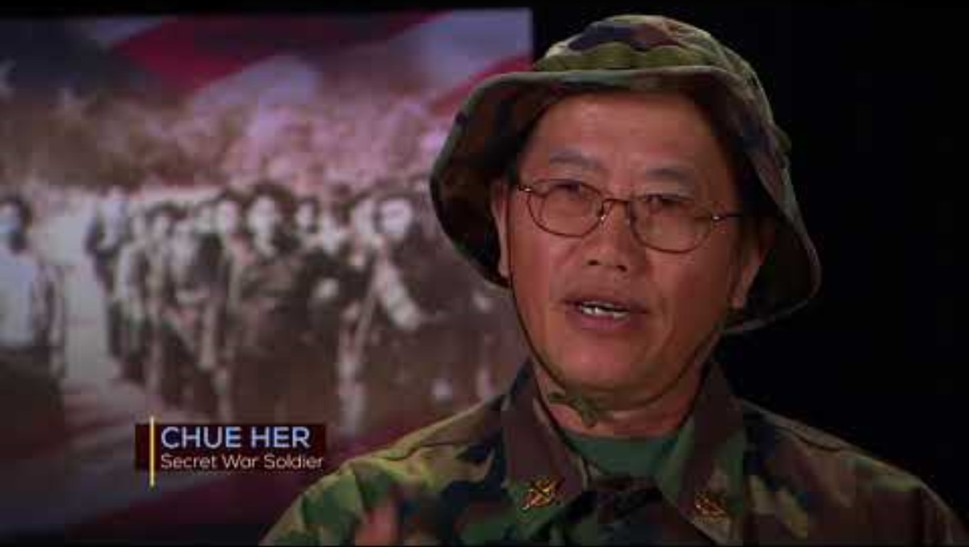
Hmong Soldiers That Served Alongside American Troops in Vietnam
Notes:
Explain (Slides 3 & 4) Video - Have students watch the video “10thirtysix | Exclusive | The Secret War: Hmong Soldiers Who Served Alongside Americans in Vietnam”
https://www.youtube.com/watch?v=1_0WbPq2lhs (16 mins) and on the slide notes to the right of the video, on a google doc or use pen and paper, have them write TQE (Thoughts, Questions and Epiphanies).
Teacher Notes: Important facts from the video -
Chue Her - Secret War Soldier describes his experience in a reeducation camp.
Thai Vue describes his near death experience being attacked by the Laotian communist soldiers and his escape across the Mekong River to the Thai Refugee Camp.
Hmong young men and then boys, joined as foot soldiers to fight the communists in Laos and then in Vietnam
CIA agent Bill Lair recruited General Vang Pao who was Hmong.
General Vang Pao recruited 1000s of Hmong men and boys. Boys as young as 11 years old.
In return Hmong received rice and humanitarian aid
Hmong soldiers served as the role of what US soldiers would do if they were sent to Laos.
They rescued US fighter pilots who were shot down.
Dr. Chia Vang, scholar and professor author of the book “Hmong America '' - describes her escape through the jungle as a child with their family to a Thai Refugee camp. “We, the Hmong have a very unique experience in that we were caught in global confrontations. We had a unique situation because of Laos’ neutrality, without the Hmong, many American lives wouldn’t have been saved, they helped save downed American pilots. And we were the foot soldiers so that 40,000 American soldiers didn’t have to go to Laos.”
After the US left in 1973 and after the Fall of Saigon, the Hmong were left to fight for themselves against the communists.
Evacuation for the Hmong was not planned or organized, the few who made it on the few planes that left Laos had to fight their way among 1000s of people running after the plane.
The Hmong soldiers who fought for the US in Laos are not officially recognized as Vietnam War Vets, so they do not qualify for any veteran benefits.
In spite of no recognition, both interviewees, Chue Her and Thai Vue are happy to be in the US where they can live their lives freely.

Slide 4
Hmong Soldiers That Served Alongside American Troops in Vietnam
Saib daim vis dis aus thiab sau cia hauv qab no. Tom qab ntawd ua qhov TQE (Xav, Lus Nug, Xav Tias Yuav Zoo Cas)
Cov lus cim tseg
Cov lus xav
Lus nug
Xav tias yuav zoo cas

Slide 5
Geneva and US Actions
Nyeem daim duab ntawv xov xwm thiab nyeem cov ntawv. Sib tham nrog tus khub/pab pawg nyob saum rooj:
Tej hauj lwm hauv Teb Chaws Nplog muaj feem cuam rau lub tswv yim domino li cas?
Tau muaj kev cog lus hauv ntawv Geneva Accords li cas rau Tebchaws Nplog?
Tus Nom Kennedy txiav txim li cas rau xyoo 1961?
Koj xav tias vim li cas tus nom txib koom haum CIA los mus ntiav cov Hmoob mus tawm tsam khoos mus niv hauv Tebchaws Nplog?
Notes:
Explain (Slide 5) Primary Resource Analysis - CIA Document https://chroniclingamerica.loc.gov/lccn/sn83045462/1963-04-20/ed-1/seq-21/#date1=1777&index=18&rows=20&words=accords+Geneva+Laos&searchType=basic&sequence=0&state=&date2=1963&proxtext=geneva+accord+laos&y=0&x=0&dateFilterType=yearRange&page=1
How does activity in Laos connect to the Domino theory? According to the Truman Doctrine, when one nation falls to communism the next one will fall as well is the Domino Theory. President Kennedy feared that if Laos were to fall to the communist, then South Vietnam would be next. At the time of the Vietnam War, Laos was being ruled by a coalition government of the Pathet Lao (pro-communist), the neutralists and the Royal Government (anti-communists supported by the U.S.).
What was guaranteed to Laos in the Geneva Accords? Under the Geneva Accords, which was an agreement signed by 14 nations in 1954, Laos would be guaranteed neutrality (and be allowed to stay out of any conflict within Vietnam)
What decision did President Kennedy make in 1961? President Kennedy decided not to send in any U.S. troops to support the Royal Laotian government in 1961. And this article implies that President Kennedy, in 1963, is still intent on not sending in U.S. troops.
Why did the US recruit the Hmong people to fight in the Secret War in Laos? Since it looked like northern Laos was going to fall to communism because the Pathet Lao was attacking them, and President Eisenhower has promised the American people he would not send U.S. soldiers into Laos and Laos was guaranteed neutrality, the president may have felt that there was a need to hire the Hmong to fight the war for the U.S. on the ground level (Inference)
How did the CIA recruit the Hmong to fight the communist in Laos? The CIA operative Bill Lair worked with Hmong General Vang Pao, educated in Northern Laos, on an agreement to recruit Hmong as soldiers to fight the communists. For the Hmong, in Northern Laos, they felt they were going to be attacked by the Laotions, so they agreed because the U.S. CIA provided them with weapons, uniforms and rice. They were supplied with weapons that had been left over from WWII. The Hmong were also trained to fly fighter planes to drop bombs where the Ho Chi Minh Trail was thought to have been. The Hmong soldiers also rescued U.S. pilots from downed planes. At first 1,000 men were recruited, then 4,000, then 10,000. Radios were used as a way to convince the Hmong that communism was bad. Hmong males as young as 11 were recruited to fight as soldiers, some too small to hold the M-16s they were given.

Slide 6
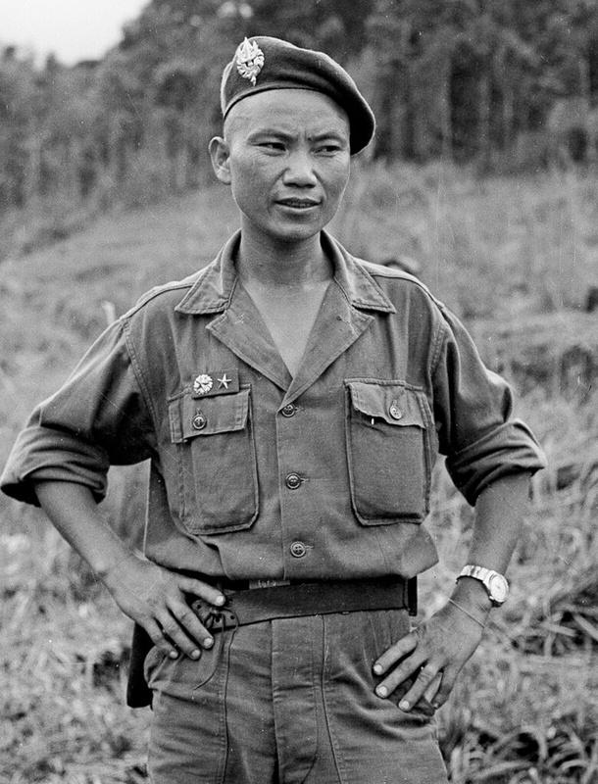
Nai Phoo Vaj Pov
"Thaum nws tseem yog tub hluas, nws tau tawm tsam neeg Yij Pooj thaum muaj Kob Tsov Rog Ntiaj Teb Zaum II, thiab tau tuaj Fab Kis tog tawm tsam Nyab Laj Qaum Teb thaj tsam xyoo 1950.
Nws tau koom tes nrog CIA ua tsov rog zais tsis qhia twg paub nyob hauv Kob Tsov Rog Nyab Laj thiab thaum lawv swb rog lawm, nws coj tau nws haiv neeg khiav.
Tus nom CIA qub thaum ub William Colby hais tias [Vang] ‘yog tus phab ej tshaj lij tshaj hauv Kob Tsov Rog Nyab Laj’.”
(Los ntawm: BBC)
-Image Source: manhhai. (2022, February 11). Commander Vang Pao 1961 [Photograph]. Flickr.
Notes:
Explain (Slide 6) Primary Resource Analysis - Vang Pao Quote
"As a young man, he had fought against the Japanese during World War II, and with the French against the North Vietnamese in the 1950s. He led a CIA-sponsored secret war in Laos during the Vietnam War and, when it was lost, led many of his people into exile. Former Central Intelligence Agency chief William Colby once called [Vang] 'the biggest hero of the Vietnam War'." Source: BBC

Slide 7
Geneva and US Actions
Thaum nug txog tias Meskas tiv tauj tau nrog nws li cas, Vaj Pov piav hais tias...
Lawv yeej tsis tau ua ntawv cog lus los sis tham kom sib haum lus li. Lawv cia li tuaj saib ib ncig, Lawv pom cov Hmoob txom nyem heev-tsis muaj ntsev noj...tsis muaj khaub ncaws hnav, ces thaum cov Meskas tuaj txog, lawv hais tias, "Koj puas xav kom Hmoob tau ntsev noj?" Yog li ntawd Meskas thiaj coj ntsev tuaj pov rau txhua qhov chaw rau Hmoob. Thiab thaum lub caij ntuj no los txog ces no heev, Meskas nug tias, "Koj puas xav kom Hmoob muaj khaub ncaws hnav?" Cov Hmoob txom nyem heev, yog li ntawd lawv nqa khaub ncaws tuaj pov saum ntuj los rau Hmoob...Ces muaj ib hnub lawv coj ib co phom...Thiab tag ntawd nqa tej xov tooj cua tuaj...ces muaj ib leeg ib lub rau cov coj ntawm Hmoob. Nyob rau lub sij hawm ntawd peb twb yeej muaj xov tooj cua sib txuas lus nyob txhua qhov chaw lawm. Ces lawv maj mam pib li no mus...Lawv tsuas yog nug peb hais tias, "Koj puas xav tau qhov no? Koj puas xav tau qhov tov?" Yog, peb yeej xav tau qhov no, qhov tov, peb txom nyem heev ne...Yog li thaum muaj kev tsov rog, lawv hais kom peb pab, ces peb thiaj tau paub...[T]us huab kuj tso cai. Yog vim li ntawd kuv thiaj li pab Meskas.” (Chaw Muaj Ntaub Ntawv: Hillmer, P. (2015). A people's history of the Hmong. Minnesota Historical Society.)
Notes:
Explain (Slide 7) Primary Resource Analysis - Vang Pao Quote “ When asked how the Americans contacted him, Vang Pao describes…
They never came to make this agreement or that agreement. They just came looking around, They saw the Hmong were very poor in many ways- no salt to eat… no clothes to wear, so when Americans came, they said, “Do you want salt for the Hmong?” So Americans dropped salt everywhere for the Hmong. And when the winter came and it was very cold, the Americans asked, “Do you need clothes for the Hmong?” The Hmong are very poor, so they dropped clothes from the sky for the Hmong… Then one day they brought carbines… And then they brought in… communication radios and gave one to each Hmong chief. At that time we already had communication everywhere. So slowly, slowly, that’s how we did it… All they did was say, “Do you need this? Do you need that?” Yes, we needed this, we needed that, we were very poor… So when the war came, they asked for our help, and we helped… [T]he king also gave his consent. So that’s why I helped the Americans.” (Source: Hillmer, P. (2015). A People's History of the Hmong. 84. Minnesota Historical Society.)
Based on Vang Pao’s quote, what enticed the Hmong to become soldiers and join the Secret War? He describes the Hmong as being poor, so clothes, salt, food and radios seemed very enticing for a poor agrarian community.

Slide 8
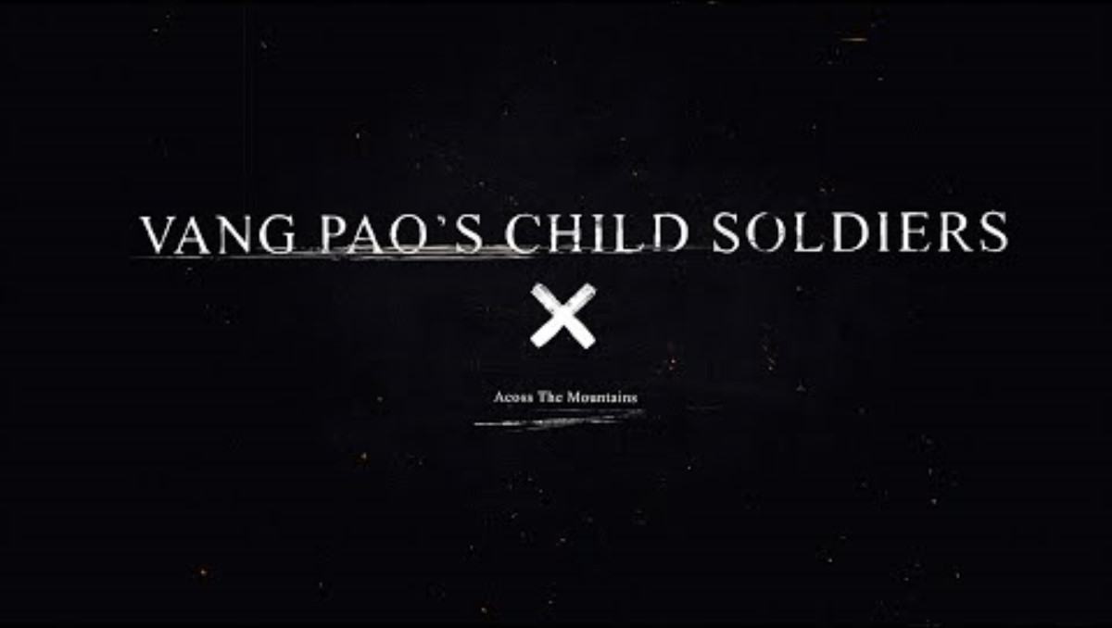
Hmong Child Soldiers in the Secret War
Notes:
Have students watch the The Child Soldiers of Vang Pao's Army video https://www.youtube.com/watch?v=HBeQzheWskY (4 mins) and on a google doc or pen and paper, have them write their TQE (Thoughts, Questions and Epiphanies) about the video. Debrief as a class.

Slide 9
Hmong Child Soldiers in the Secret War
Saib daim vis dis aus thiab sau cia hauv qab no. Tom qab ntawd ua qhov TQE (Xav, Lus Nug, Xav Tias Yuav Zoo Cas)
Cov lus cim tseg
Cov lus xav
Lus nug
Xav tias yuav zoo cas
Notes:
Have students watch the The Child Soldiers of Vang Pao's Army video https://www.youtube.com/watch?v=HBeQzheWskY (4 mins) and on a google doc or pen and paper, have them write their TQE (Thoughts, Questions and Epiphanies) about the video. Debrief as a class.

Slide 10
CIA Air Operations in Laos, 1955-1974
Directions
Read the article.
Answer the two questions that follow.
Cov lus nug
Vim li cas Meskas thiaj li ntiav tau cov Hmoob mus tua rog nyob rau Kob Tsov Rog Qab Rooj hauv Tebchaws Nplog?
Kob Tsov Rog Qab Rooj ua nyob rau qhov twg?
Notes:
Have students read the following sections of CIA Air Operations in Laos, 1955-1974 Supporting the "Secret War" by William M. Leary https://web.archive.org/web/20201116105808/https://www.cia.gov/library/center-for-the-study-of-intelligence/csi-publications/csi-studies/studies/winter99-00/art7.html (in the slide, click on the Library of Congress image to access the article from the CIA website). Have students read it silently or in pairs. Then answer the questions in the green and white boxes.
Concern About Laos
Supporting the Anti-Communists
The PARU Program
Enter Vang Pao
Why did the U.S. recruit the Hmong people to fight in the Secret War in Laos? According to the Geneva Convention, the U.S. was not allowed to intervene in Laos as they were considered neutral. So in essence the U.S. did not “intervene” because the U.S. did not use any U.S. soldiers to fight on the ground in Laos. Instead they sent in CIA operatives to recruit Hmong soldiers to fight for the U.S. These Hmong soldiers fought in the name of the U.S. against the Viet Cong - North Vietnam Communist soldiers.
How did the Secret War take place? The Secret War took place in which the Hmong soldiers fought the North Vietnamese Communist in Laos, bombing the Ho Chi Minh Trail, rescuing U.S. fighter pilots, and fighting the Laotian communists. U.S. fighter planes dropped This was done without U.S. Congressional approval and without knowledge from the American people.

Slide 11
US Bombing in Laos Facts
Muaj ntau tshaj li 270 phlom cov hoob pob raug cuam rau hauv Tebchaws Nplog sij hawm Kob Tsov Rog Nyab Laj (tshaj 210 phlom lub hoob pob uas tau muab cuam rau Tebchaws Is Lav xyoo 1991, 1998 thiab 2006 sib txuam ua ke); ntau txog 80 plhom lub hoob pob tsis tau tawg.
Ze li ntawm 40 xyoo dhau los, muaj tsawg tshaj 1% cov hoob pob no raug rhuav tshem. Muaj tshaj li ib nrab cov teeb meem uas tib neeg tuag vim yog hoob pob uas tshwm sim thoob ntiaj teb uas feem ntau tshwm sim nyob hauv Tebchaws Nplog.
Txhua xyoo tam sim no muaj li ntawm 50 leej neeg tuag tshiab nyob hauv Tebchaws Nplog, nqis tshaj 310 leej nyob rau xyoo 2008. Ze li ntawm 60% cov teeb meem ua rau muaj neeg tuag, thiab 40% cov raug tuag no yog me nyuam yaus.
Thaj tsam xyoo 1993 thiab 2016, Tebchaws Meskas tau pab nyiaj thaj tsam $4.9 Lab rau ib xyoos twg rau UXO los tu cov hoob pob nyob Tebchaws Nplog; Tebchaws Meskas tau siv $13.3 Lab rau ib hnub twg(daus las xyoo 2013) lub sij hawm 9 xyoos uas cuam hoob pob hauv Tebchaws Nplog.
Tsuas yog li ntawm 10 hnub cuam hoob pob rau hauv Tebchaws Nplog, Tebchaws Meskas tau siv tag $130 Lab (daus las xyoo 2013), ntau tshaj qhov nws siv los mus khaws cov hoob pob uas tsis tau tawg nyob rau sij hawm 24 lub xyoos dhau los ($118 Lab).
Notes:
Analyze the map of the secret U.S. bombings in Laos and read through the facts from (https://legaciesofwar.org/about-laos/secret-war-laos/)

Slide 12
US Bombing in Laos Facts
Cov lus nug
Koj pom tias cov Meskas cuam hoob poob rau qhov twg hauv Tebchaws Nplog?
Koj xav tias kev cuam cov hoob pob no cuam tshuam cov Hmoob hauv Tebchaws Nplog li cas?
Image: Map showing US Bombing in Laos
Notes:
Answer the questions.
What do you notice about where the U.S. dropped bombs in Laos? Possible answers. Along the border with Vietnam at first but later, throughout Laos.
How do you think the bombing impacted the Hmong population in Laos? Possible answers. Laos is the most bombed country in the world, the majority of the Laotian population including the Hmong were affected in devastating ways. The loss of life, the loss of their way of life, the loss of their homeland, all created a destabilizing feeling and trauma within the Hmong and Laotian population. Still today there are undetonated bombs in Laos.

Slide 13
Take a Stand
Mus rau qaum teb (pom zoo) los sis qab teb (tsis pom zoo) ntawm chav kawm no raws seb koj tuaj leej twg tog raws li cov nqe lus hauv qab no hais. Sib tham nrog lwm tus kawm thiab npaj piav qhov koj xav.
Tej uas Tebchaws Meskas ua thaum sij hawm xyoo 1960 yeej mus raws cov lus cog tseg Geneva Accords hais.
(Tebchaws Meskas tes hauj lwm = ua tsov rog tsis qhia leej twg paub nyob hauv Teb Chaws Nplog; uas Tebchaws Meskas CIA pub zaub mov, muab riam phom los ntiav Hmoob tawm tsam khoos mus niv. Muab hais los , cov Hmoob sawv cev rau Meskas sib tua hauv av hauv Tebchaws Nplog. Qhov no muab npog zais tsis qhia Ceg Hauj Lwm Cai Lij Choj Tebchaws Meskas thiab pej xeem Meskas paub li.)
Notes:
Thrash Out Exercise:
Teachers post up a position on a spectrum with one end Strongly Agree and the other end Strongly Disagree regarding the statement(s): “The US actions during the 1960s fell in line with the Geneva Accords” or any other provocative statement.
Students go to a position, discuss and then students are free to change their position after the share out.

Slide 14
Hauv Kev Ntaus Nqi: Menu Board
Xaiv ib yam ntawm cov hauv qab no txhawm rau los qhia txog lawv li kev nkag siab txog Kob Tsov Rog Qab Rooj:
Los ntawm qhov ntau (cov tub rog, cov npoos, cov xyoo, thiab lwm yam)
Cov duab xwm txheej
Cov ntawv tshaj xov xwm (xov tooj cua los sis this vis) kaw tseg nyob rau Flipgrid chaw sau qhia keeb kwm
Ua ib tug kws tshaj xov xwm uas nthuav tawm Kob Tsov Rog Qab Rooj nyob rau hauv xyoo 1973 los tau.
Xam phaj qee tus neeg hauv zej zog Hmoob los sis saib/mloog ib tug Hmoob piav keeb kwm hais ntawm ncauj - sau ib zaj paj huam qhia txog tej lawv raug.
Cov duab ntawm Kob Tsov Rog Qab Rooj thiab qhov tseem ceeb txog Kob Tsov Rog Qab Rooj hauv Tebchaws Nplog.
Tsab Ntawv rau qub tub rog Hmoob thov txim rau tej kev txom nyem lawv raug thiab kev lawv tsis tau txais kev lees paub los ntawm tsoom fwv rau tej uas lawv tau ua.
Notes:
Assessment Options: Menu Board
By The Numbers (soldiers, bombs, years, etc)
Students will utilize the numbers in the content of the presentation and resources to create a creative display of the numbers of details of the Secret War
Infographic of major events
Have students choose 4 pivotal events that makeup the Secret War and create an infographic.
The infographic should include: event names, descriptions, images, captions, statistics, text, etc.
News report (radio or tv) recorded on Flipgrid (or other recording application)
Students should first submit a storyboard submission of their speaking parts
Students can also take on the role of a news investigative reporter who exposes the Secret War in 1973
Interview someone from the Hmong community
Alternatively, students can watch/listen to a Hmong oral history interview https://digitalcommons.csp.edu/hmong-studies_hohp/
Students will share their takeaways from the interview/oral history by creating a written reflection. This can also be done as a reflective poem.
Collage of photos of the Secret War and important facts coming out about the Secret War in Laos.
Letter to a Hmong veteran
Suggested content: Empathy for their suffering and lack of recognition for their sacrifice
Write a formal Congressional Resolution
Suggested content: Recognize and/or apologize to the Hmong veterans for their contributions to the U.S. War efforts during the Secret War in Laos
Sharing and Reflection
Allow students to share their final assessment through one of the following options: Gallery Walk, Give One/Get One, Video Reflection, Lines of Communication, or Small Group/Whole Class Presentation.

Slide 15
References
Across The Mountains. (2023, January 12). The child soldiers of Vang Pao’s Army [Video]. YouTube. https://www.youtube.com/watch?v=HBeQzheWskY
Central Intelligence Agency (CIA). (2008, June 27). CIA air operations in Laos, 1955-1974: Supporting the "Secret War.” https://web.archive.org/web/20201116105808/https://www.cia.gov/library/center-for-the-study-of-intelligence/csi-publications/csi-studies/studies/winter99-00/art7.htmlEvening Star. (1963, April 20). Chronicling America: Historic American newspapers. Library of Congress, Washington D.C.
Hillmer, P. (2015). A people's history of the Hmong. Minnesota Historical Society.
Legacies of War. (n.d.). Legacies library: Resources on the American Secret War in Laos. https://legaciesofwar.org/about-laos/secret-war-laos/
manhhai. (2022, February 11). Commander Vang Pao 1961 [Photograph]. Flickr. flickr.com/photos/13476480@N07/51875071173
Marlette, D. (1972). "--And, of course, if Cambodia fell, then Laos would fall, and if Laos fell ...." / Marlette. [Photograph]. Retrieved from the Library of Congress, https://www.loc.gov/item/2008677233/
Milwaukee PBS. (2017, September 25). 10thirtysix | Exclusive | The Secret War: Hmong Soldiers who served alongside Americans in Vietnam [Video]. YouTube. https://youtu.be/1_0WbPq2lhs
Notes:
Assessment Options: Menu Board
By The Numbers (soldiers, bombs, years, etc)
Students will utilize the numbers in the content of the presentation and resources to create a creative display of the numbers of details of the Secret War
Infographic of major events
Have students choose 4 pivotal events that makeup the Secret War and create an infographic.
The infographic should include: event names, descriptions, images, captions, statistics, text, etc.
News report (radio or tv) recorded on Flipgrid (or other recording application)
Students should first submit a storyboard submission of their speaking parts
Students can also take on the role of a news investigative reporter who exposes the Secret War in 1973
Interview someone from the Hmong community
Alternatively, students can watch/listen to a Hmong oral history interview https://digitalcommons.csp.edu/hmong-studies_hohp/
Students will share their takeaways from the interview/oral history by creating a written reflection. This can also be done as a reflective poem.
Collage of photos of the Secret War and important facts coming out about the Secret War in Laos.
Letter to a Hmong veteran
Suggested content: Empathy for their suffering and lack of recognition for their sacrifice
Write a formal Congressional Resolution
Suggested content: Recognize and/or apologize to the Hmong veterans for their contributions to the U.S. War efforts during the Secret War in Laos
Sharing and Reflection
Allow students to share their final assessment through one of the following options: Gallery Walk, Give One/Get One, Video Reflection, Lines of Communication, or Small Group/Whole Class Presentation.

