Slide 1
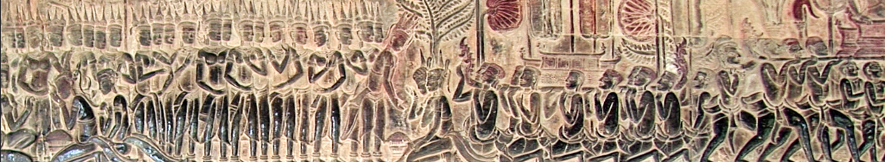
កម្មវិធីសិក្សា គំរូខ្មែរ-អាមេរិកាំង ឆ្នាំ 2024
របួសផ្លូវចិត្តបន្តជំនាន់ និងជនជាតិខ្មែរអាមេរិកាំង
CASMC
Cambodian American Studies Model Curriculum
Notes:
Area of Study: Cambodian Diaspora
Compelling Question: What is the Cambodian diaspora and refugee experience?
Lesson Objective: Students will learn why people seek refuge, understand what refugee camps are like and where they were for Cambodian refugees after 1975, grasp how resettlement impacts refugees and their places of refuge, and differentiate between asylum seekers and refugees.
Lesson Question (Supporting Question): What are the characteristics of Cambodian Refugees post 1975?
Lesson Background:
From 1975-1979 the Khmer Rouge under Pol Pot attempted to create an agrarian utopia in Cambodia. In doing so they emptied the cities and place citizens into rural forced labor camps. Intellectuals, supporters of the former government and minorities are targeted for torture and execution. The Khmer Rouge’s policies led to famine and mass starvation. During their reign nearly 2 million Cambodians died in what would become know as the Cambodian Genocide. The genocide ended when Vietnam invaded Cambodia in 1979. Many Cambodian citizens fled their homeland during the Khmer Rouge period and during the Vietnamese occupation. These refugees experienced additional trauma from the harsh conditions in refugee camps and subsequent relocation to an unfamiliar country with little support. This lesson will introduce the concept of generational trauma to students. By the end of this lesson, students will understand how traumatic experiences in Cambodian American history can be manifested today in different forms. This lesson is particularly important for Social Studies teachers to teach because this topic is not only relevant to Cambodian Americans, but also to other marginalized groups.

Slide 2
និយមន័យ៖ របួសផ្លូវចិត្ត
គឺជាប្រតិកម្មផ្លូវចិត្តចំពោះព្រឹត្តិការណ៍ដ៏អាក្រក់មួយ ដូចជាគ្រោះថ្នាក់ដែលមានការគំរាមកំហែងដល់អាយុជីវិត ឬគ្រោះមហន្តរាយធម្មជាតិ។ (ចិត្តវិទ្យាពេលបច្ចុប្បន្ន)

Slide 3
និយមន័យ៖ ជំនាន់
ក្រុមជំនាន់ ដែលជារឿយៗគេហៅថាក្រុម រួមមានអ្នកដែលចែករំលែកបទពិសោធន៍ប្រវត្តិសាស្ត្រជីវិត ឬសង្គមរួមគ្នា ដែលឥទ្ធិពលរបស់វាបន្តមានស្ថេរភាពនៅក្នុងដំណើរជីវិតរបស់ពួកគេ។ បទពិសោធន៍​ជីវិត​ទាំងអស់នេះ​ហាក់ដូចជាមានភាពខុសគ្នាពីមួយជំនាន់​​ទៅមួយជំនាន់​ទៀត។ (Jurkiewicz & Brown 1998)។

Slide 4
និយមន័យ៖ របួសផ្លូវចិត្តបន្តជំនាន់
ផលប៉ះពាល់នៃបទពិសោធន៍ដ៏តក់ស្លុតដែលបានកើតឡើងក្នុងវ័យកុមារ ឬមនុស្សពេញវ័យ ដែលរបួសផ្លុវចិត្តនេះបានផ្ទេរបន្ត ឬឆ្លងពីឪពុកម្តាយទៅកូន និងបន្តដល់ជំនាន់ជាបន្តបន្ទាប់ទៀត។ (Bombay, Matheson, and Anisman 2009)

Slide 5
កិច្ចការក្រុម
ចូរបង្កើតបញ្ជីព្រឹត្តិការណ៍ដែលធ្វើឱ្យប៉ះពាល់ដល់ផ្លូវចិត្តជនជាតិខ្មែរអាមេរិកាំង និងផលប៉ះពាល់ដល់សហគមន៍របស់ពួកគេគ្រប់ជំនាន់។
Notes:
Have students get into groups of 3–4 and ask them to create a list of traumatic
events experienced by Cambodian Americans that may have impacted their
communities across generations.
Share-out:
i. Call on students to share their ideas. Guide them to these issues:
Loss of land and their resources
Family members being killed for no reason
Not being able to practice their religion
Loss of language and cultural practices
Being taken away/separated from family
Punished for any small “wrong-doing”
Being anxious about leaving your home in fear of something bad happening
3. To bring students to the main idea, say: “All of these things that happened many
years ago still have an impact on Cambodian Americans today, but in a much
more serious way, than just not being able to visit certain locations or participate
in certain activities. The ways the past generations coped with these experiences
have been unconsciously passed down to other generations.”
Share the following quotes with students:
“The transmission of trauma may be particular to a given family suffering a loss, such as the death of an infant, or it can be a shared response to societal trauma.” (Psychology Today)
“Sometimes anxiety falls from one generation to the next through stories told.” (Psychology Today)
“Adult offspring of Holocaust survivors showed significantly higher levels of self-reported childhood trauma, particularly emotional abuse and neglect, relative to comparison subjects.” (Yehuda, Halligan, Grossman 2001)

Slide 6
សម្រង់ខ្លឹមសារ
"ការឆ្លងរបួសផ្លូវចិត្តបន្តជាពិសេសកើតមានចំពោះគ្រួសារដែលទទួលរងការបាត់បង់ធ្ងន់ធ្ងរ ដូចជាការស្លាប់របស់ទារក ឬវាអាចជាការឆ្លើយតបរួមគ្នាចំពោះរបួសផ្លូវចិត្តក្នុងសង្គម។" (ចិត្តវិទ្យាបច្ចុប្បន្ននេះ)
«ជួនកាលជម្ងឺឆាប់ភ័យខ្លាចនេះអាចកើតពីមួយជំនាន់ទៅមួយជំនាន់ទៀតតាមរយៈរឿងរ៉ាវដែលបានប្រាប់បន្ត»។ (ចិត្តវិទ្យាបច្ចុប្បន្ននេះ)
“ការសិក្សា បានរកឃើញថា មនុស្សពេញវ័យដែលមានឪពុកម្តាយបានរស់រានមានជីវិតពីការសម្លាប់រង្គាលបានរាយការណ៍ថាមានរបួសផ្លូវចិត្តពីកុមារភាពយ៉ាងច្រើន ជាពិសេសទាក់ទងនឹងការរំលោភបំពានផ្លូវចិត្ត និងការព្រងើយកន្តើយ បើប្រៀបធៀបទៅនឹងអ្នកដែលមិនមានប្រវត្តិបែបនេះ” (Yehuda, Halligan, Grossman 2001)
Notes:
Have students get into groups of 3–4 and ask them to create a list of traumatic
events experienced by Cambodian Americans that may have impacted their
communities across generations.
Share-out:
i. Call on students to share their ideas. Guide them to these issues:
Loss of land and their resources.
Family members being killed for no reason.
Not being able to practice their religion.
Loss of language and cultural practices.
Being taken away/separated from family.
Punished for any small “wrong-doing.”
Being anxious about leaving your home in fear of something bad happening.
3. To bring students to the main idea, say: “All of these things that happened many
years ago still have an impact on Cambodian Americans today, but in a much more serious way, than just not being able to visit certain locations or participate in certain activities. The ways the past generations coped with these experiences
have been unconsciously passed down to other generations.”
Share the following quotes with students:
“The transmission of trauma may be particular to a given family suffering a loss, such as the death of an infant, or it can be a shared response to societal trauma.” (Psychology Today)
“Sometimes anxiety falls from one generation to the next through stories told.” (Psychology Today)
“Adult offspring of Holocaust survivors showed significantly higher levels of self-reported childhood trauma, particularly emotional abuse and neglect, relative to comparison subjects.” (Yehuda, Halligan, Grossman 2001)

Slide 7
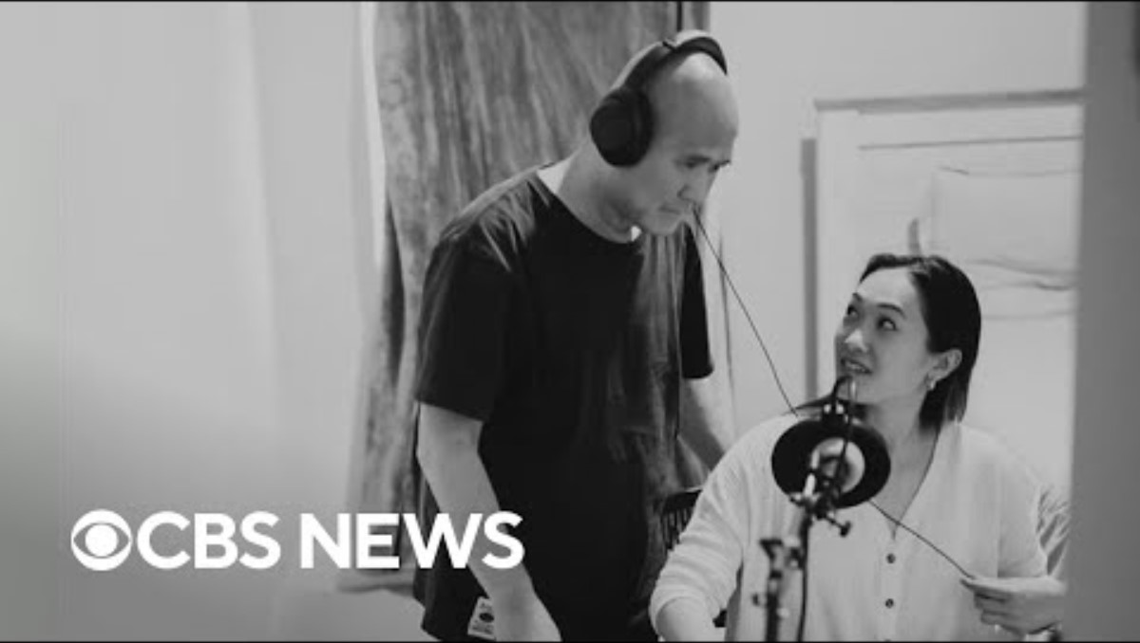
បទពិសោធន៍ជនភៀសខ្លួនកម្ពុជា-អាមេរិកាំង
Notes:
Have students get into groups of 3–4 and ask them to create a list of traumatic
events experienced by Cambodian Americans that may have impacted their
communities across generations.
Share-out:
i. Call on students to share their ideas. Guide them to these issues:
Loss of land and their resources.
Family members being killed for no reason.
Not being able to practice their religion.
Loss of language and cultural practices.
Being taken away/separated from family.
Punished for any small “wrong-doing.”
Being anxious about leaving your home in fear of something bad happening.
3. To bring students to the main idea, say: “All of these things that happened many
years ago still have an impact on Cambodian Americans today, but in a much more serious way, than just not being able to visit certain locations or participate in certain activities. The ways the past generations coped with these experiences
have been unconsciously passed down to other generations.”
Share the following quotes with students:
“The transmission of trauma may be particular to a given family suffering a loss, such as the death of an infant, or it can be a shared response to societal trauma.” (Psychology Today)
“Sometimes anxiety falls from one generation to the next through stories told.” (Psychology Today)
“Adult offspring of Holocaust survivors showed significantly higher levels of self-reported childhood trauma, particularly emotional abuse and neglect, relative to comparison subjects.” (Yehuda, Halligan, Grossman 2001)

Slide 8
សំណួរ​ពិភាក្សាអំពីវីដេអូ​ (1-4)
តើអ្នកមានប្រតិកម្មយ៉ាងណាដែរចំពោះវីដេអូនេះ?
តើមានអ្វីប្លែកដែលធ្វើឱ្យអ្នកមានចំណាប់អារម្មណ៍ខ្លាំងទេ?
តើអ្នកបានរៀនអ្វីថ្មីខ្លះទេ?
នេះ​គឺជា​ឱកាស​សម្រាប់​សិស្ស​ដើម្បី​ចែករំលែក​ពីប្រតិកម្ម​របស់​ពួកគេ។ គ្មាន​ចម្លើយ​ត្រូវ​ឬ​ខុស​ទេ ប៉ុន្តែ​សូមលើក​ទឹកចិត្ត​ពួកគេ​ឱ្យ​ចេះ​គោរពគ្នាទៅវិញទៅមក និង​ពិចារណា​ឱ្យបានស៊ីជម្រៅ។ គ្រូអាចធ្វើការចែករំលែកគំនិតរបស់ពួកគេជាមុនសិន ក្នុងករណីដែលសិស្សមានអារម្មណ៍ភ័យខ្លាចក្នុងការឆ្លើយតប។
Notes:
Have students get into groups of 3–4 and ask them to create a list of traumatic
events experienced by Cambodian Americans that may have impacted their
communities across generations.
Share-out:
i. Call on students to share their ideas. Guide them to these issues:
Loss of land and their resources.
Family members being killed for no reason.
Not being able to practice their religion.
Loss of language and cultural practices.
Being taken away/separated from family.
Punished for any small “wrong-doing.”
Being anxious about leaving your home in fear of something bad happening.
3. To bring students to the main idea, say: “All of these things that happened many
years ago still have an impact on Cambodian Americans today, but in a much more serious way, than just not being able to visit certain locations or participate in certain activities. The ways the past generations coped with these experiences
have been unconsciously passed down to other generations.”
Share the following quotes with students:
“The transmission of trauma may be particular to a given family suffering a loss, such as the death of an infant, or it can be a shared response to societal trauma.” (Psychology Today)
“Sometimes anxiety falls from one generation to the next through stories told.” (Psychology Today)
“Adult offspring of Holocaust survivors showed significantly higher levels of self-reported childhood trauma, particularly emotional abuse and neglect, relative to comparison subjects.” (Yehuda, Halligan, Grossman 2001)

Slide 9
សំណួរ​ពិភាក្សាអំពីវីដេអូ​ (5-7)
សូមរៀបរាប់ពីរបៀបដែលDorothy Chow ធំលូតលាស់ និងរបៀបដែលប្រវត្តិសាស្ត្រកម្ពុជាបានជះឥទ្ធិពលទៅលើដំណើរជីវិតរបស់នាង។
តើ​របួស​ផ្លូវចិត្តបាន​កើត​ឡើង​របៀប​ណា​ក្នុង​ជីវិត​របស់ Dorothy និង​ឪពុក​របស់នាង?
តើផតខាស់ (podcast) មានតួនាទីអ្វីខ្លះចំពោះរបួសផ្លូវចិត្តរបស់នាង និងការព្យាបាល?
សូមរៀបរាប់ពីការងារសិល្បៈរបស់ Phung Huynh និងរៀបរាប់ពីរបៀបដែលនាងគោរពផ្តល់តម្លៃចំពោះប្រវត្តិសាស្រ្តកម្ពុជា។
តើ​មានដំណើររឿងអ្វីខ្លះដំណាល​ពី​ជនភៀសខ្លួន​កម្ពុជា​ត្រូវបាន​គូសបញ្ជាក់នៅក្នុង​ប្រធានបទ​ការងារ​សិល្បៈ​ប្រអប់​នំ​ដូណាត់​របស់ Phung?
តើ​ទាំង Dorothy និង​ Phung បានព្យាយាម​ចាប់យក​រឿង​ប្រវត្តិសាស្ត្រ និង​វប្បធម៌​ខ្មែរ​មកនិយាយដោយ​របៀប​ណាដែរ?
តើ Dorothy និង Phung មានគោលដៅ និងក្តីសង្ឃឹមអ្វីខ្លះសម្រាប់សមាជិកសហគមន៍ជនភៀសខ្លួនទាំងអស់ក្នុងការព្យាបាលជំងឺផ្លូវចិត្ត?
Notes:
Have students get into groups of 3–4 and ask them to create a list of traumatic
events experienced by Cambodian Americans that may have impacted their
communities across generations.
Share-out:
i. Call on students to share their ideas. Guide them to these issues:
Loss of land and their resources.
Family members being killed for no reason.
Not being able to practice their religion.
Loss of language and cultural practices.
Being taken away/separated from family.
Punished for any small “wrong-doing.”
Being anxious about leaving your home in fear of something bad happening.
3. To bring students to the main idea, say: “All of these things that happened many
years ago still have an impact on Cambodian Americans today, but in a much more serious way, than just not being able to visit certain locations or participate in certain activities. The ways the past generations coped with these experiences
have been unconsciously passed down to other generations.”
Share the following quotes with students:
“The transmission of trauma may be particular to a given family suffering a loss, such as the death of an infant, or it can be a shared response to societal trauma.” (Psychology Today)
“Sometimes anxiety falls from one generation to the next through stories told.” (Psychology Today)
“Adult offspring of Holocaust survivors showed significantly higher levels of self-reported childhood trauma, particularly emotional abuse and neglect, relative to comparison subjects.” (Yehuda, Halligan, Grossman 2001)

Slide 10
ការវាយតម្លៃនៅចុងមេរៀន
សូមធ្វើការឆ្លុះបញ្ចាំងពីជីវិតផ្ទាល់ខ្លួនរបស់អ្នក តើអ្នកនឹងពណ៌នាពីទំនាក់ទំនងផ្ទាល់ខ្លួនរបស់អ្នកចំពោះវប្បធម៌របស់អ្នកយ៉ាងដូចម្តេច?
តើអ្នកមានអារម្មណ៍ថាវប្បធម៌របស់អ្នកមានសារៈសំខាន់យ៉ាងណាដែរចំពោះអត្តសញ្ញាណរបស់អ្នកក្នុងនាមជាបុគ្គលម្នាក់?
តើ​អ្នក​នឹង​មាន​អារម្មណ៍​យ៉ាង​ណា​ប្រសិន​បើ​អ្នកមិន​ត្រូវ​បាន​អនុញ្ញាត​ឱ្យ​ស្គាល់ពី​អត្តសញ្ញាណ​វប្បធម៌​របស់​អ្នកទេ?

